Slide 1
CSE 12 – Basic Data Structures and Object-Oriented Design Lecture 12
Greg Miranda & Paul Cao, Winter 2021
This lecture is being recorded

Slide 2
Announcements
Quiz 12 due Friday @ 8am
Survey 5 due Friday @ 11:59pm
PA4 due tonight @ 11:59pm
PA5 released tomorrow
Closed for collaboration

Slide 3
Topics
Questions on Lecture 12?
Combine/Sort

Slide 4
Questions on Lecture 12?

Slide 5
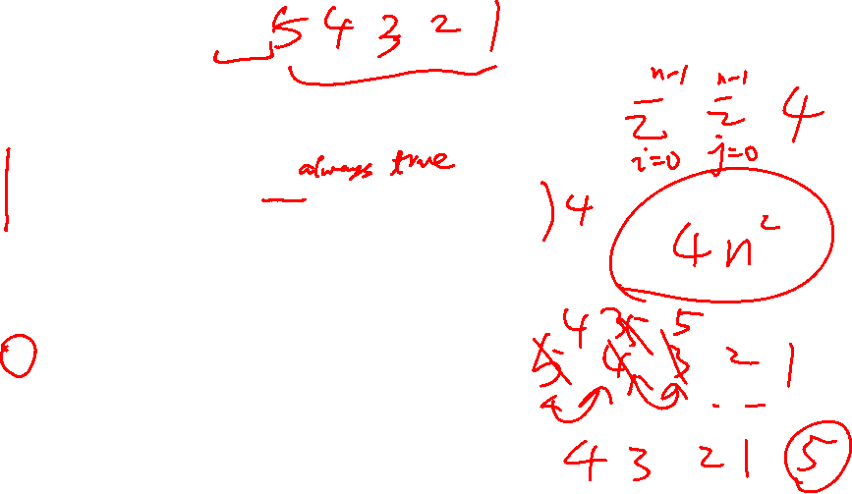
Bubble sort:
for index1 in 0 to n-1:
for index2 in 0 to n-1:
if (data[index2] > data[index2+1])
swap(data[index2], data[index2+1])
What is the worse case runtime of bubble sort?
O(n²)
O(n)
O(nlogn)
between O(nlogn) and O(n²)
Something else

Slide 6

Bubble Sort Optimization
for index1 in 0 to n-1:
swapped = False
for index2 in 0 to n-1-index1:
if (data[index2] > data[index2+1])
swap(data[index2], data[index2+1])
swapped = True
if (swapped == False)
break;

Slide 7

Bubble sort optimized:
for index1 in 0 to n-1:
swapped = False
for index2 in 0 to n-1-index1:
if (data[index2] > data[index2+1])
swap(data[index2], data[index2+1])
swapped = True
if (swapped == False)
break;
What is the worse case runtime of the optimized bubble sort?
O(n²)
O(n)
O(nlogn)
between O(nlogn) and O(n²)
Something else

Slide 8

Selection sort: Running time
Pseudocode: selectionSort
While the size of the unsorted part is greater than 1
find the position of the smallest element in the unsorted part
move this smallest element to the last position in the sorted part
increase the size of the sorted part and decrement the size of the unsorted part
Approximately how many times does the outer loop run?
1 time
N times
N² times
2
4
8
9
10
19
15
27
sorted
unsorted

Slide 9

Selection sort: Running time
Pseudocode: selectionSort
While the size of the unsorted part is greater than 1
find the position of the smallest element in the unsorted part
move this smallest element to the last position in the sorted part
increase the size of the sorted part and decrement the size of the unsorted part
Approximately how many comparisons does it take to find the smallest element in each iteration of the outer loop?
1 comparison
Always N-1 comparisons
At most N-1, but often less than N-1
2
4
8
9
10
19
15
27
sorted
unsorted

Slide 10

Selection sort: Running time
Pseudocode: selectionSort
While the size of the unsorted part is greater than 1
find the position of the smallest element in the unsorted part
move this smallest element to the last position in the sorted part
increase the size of the sorted part and decrement the size of the unsorted part
1st iter
2nd iter
3rd iter
# comparisons:
(N-1) + (N-2) + (N-3) + … + 2 + 1
2
4
8
9
10
19
15
27
sorted
unsorted

Slide 11
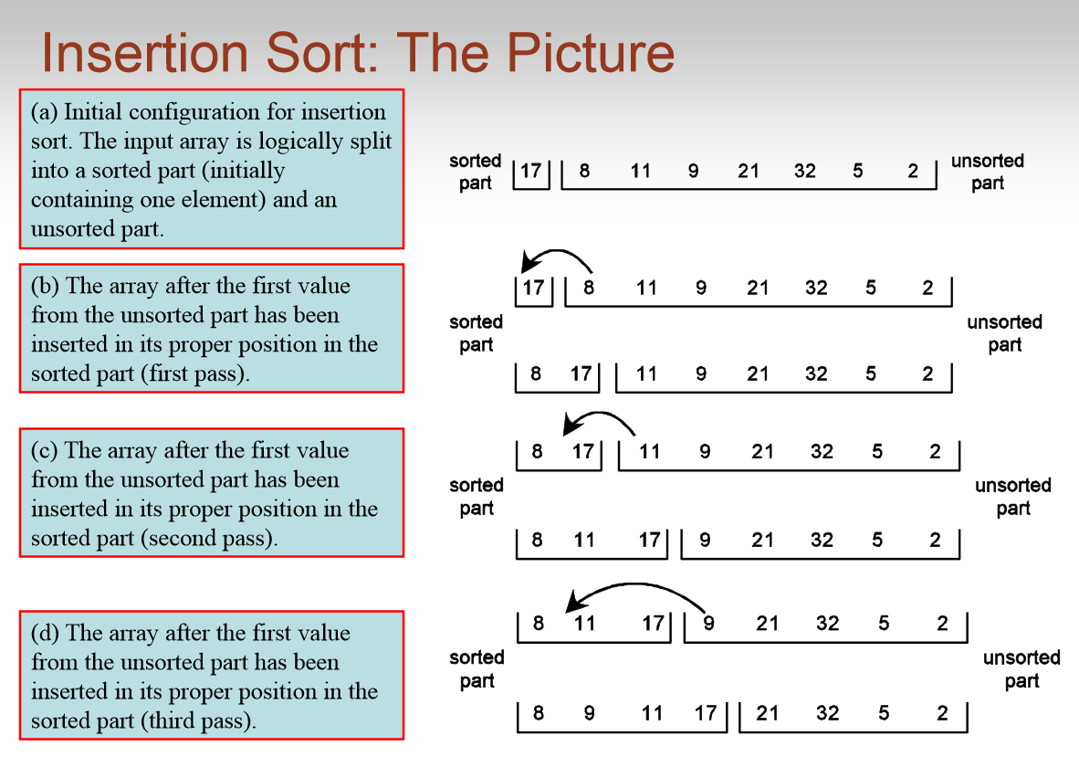
https://www.youtube.com/watch?v=ROalU379l3U

Slide 12
Insertion sort: Worst case analysis
1st iter
2nd iter
3rd iter
# comparisons:
1 + 2 + 3 + … + (N-2) + (N-1)
12
4
9
3
15
8
19
2
sorted
unsorted

Slide 13
Insertion sort: Best case analysis
Approximately how many steps does it take to insert the element into the sorted part each time through the loop in the BEST case?
1
N
N²
It depends on the length of the sorted part
2
4
9
13
15
17
19
20
sorted
unsorted

Slide 14
Array Sorting Algorithms (wiki)
Algorithm | Time Complexity
 | Best | Average | Worst
Quicksort | Ω(n log(n)) | Θ(n log(n)) | O(n^2)
Mergesort | Ω(n log(n)) | Θ(n log(n)) | O(n log(n))
Timsort | Ω(n) | Θ(n log(n)) | O(n log(n))
Heapsort | Ω(n log(n)) | Θ(n log(n)) | O(n log(n))
Bubble Sort | Ω(n) | Θ(n^2) | O(n^2)
Insertion Sort | Ω(n) | Θ(n^2) | O(n^2)
Selection Sort | Ω(n^2) | Θ(n^2) | O(n^2)
Tree Sort | Ω(n log(n)) | Θ(n log(n)) | O(n^2)
Shell Sort | Ω(n log(n)) | Θ(n(log(n))^2) | O(n(log(n))^2)
Bucket Sort | Ω(n+k) | Θ(n+k) | O(n^2)
Radix Sort | Ω(nk) | Θ(nk) | O(nk)
Counting Sort | Ω(n+k) | Θ(n+k) | O(n+k)
Cubesort | Ω(n) | Θ(n log(n)) | O(n log(n))

Slide 15

MergeSort: The Magic of Recursion
https://www.youtube.com/watch?v=XaqR3G_NVoo
Consider this magical way of sorting lists:
12
4
9
3
15
8
19
2
Split the list in half:
12
4
9
3
15
8
19
2
Magically sort each list
3
4
9
12
2
8
15
19
Merge the two lists back together
2
3
4
8
9
12
15
19

Slide 16
MergeSort: The Magic of Recursion
Consider this magical way of sorting lists:
12
4
9
3
15
8
19
2
Split the list in half:
12
4
9
3
15
8
19
2
Magically sort each list – using the same sorting method we are implementing!
3
4
9
12
2
8
15
19
Merge the two lists back together

Slide 17
MergeSort: The Magic of Recursion
Consider this magical way of sorting lists:
12
4
9
3
15
8
19
2
Split the list in half:
12
4
9
3
15
8
19
2
Magically sort each list – using the same sorting method we are implementing!
3
4
9
12
2
8
15
19
Merge the two lists back together

Slide 18

public void mergeSort( int[] toSort )
{
int mid = toSort.length / 2;
int[] firstHalf = makeList(toSort, 0, mid);
int[] secondHalf = makeList( toSort, mid, toSort.length );
mergeSort( firstHalf );
mergeSort( secondHalf );
merge( firstHalf, secondHalf, toSort );
}
Makes a new array and copies the elements from the specified range [a, b)
Merges the first two lists together into the third,
Maintaining sorted order
Does this mergeSort method work?
Yes
No

Slide 19
public void mergeSort( int[] toSort )
{
if (toSort.length > 1) {
int mid = toSort.length / 2;
int[] firstHalf = makeList(toSort, 0, mid);
int[] secondHalf = makeList( toSort, mid, toSort.length );
mergeSort( firstHalf );
mergeSort( secondHalf );
merge( firstHalf, secondHalf, toSort );
}
}
Makes a new array and copies the elements from the specified range [a, b)
Merges the first two lists together into the third,
Maintaining sorted order
This mergeSort works!!

Slide 20
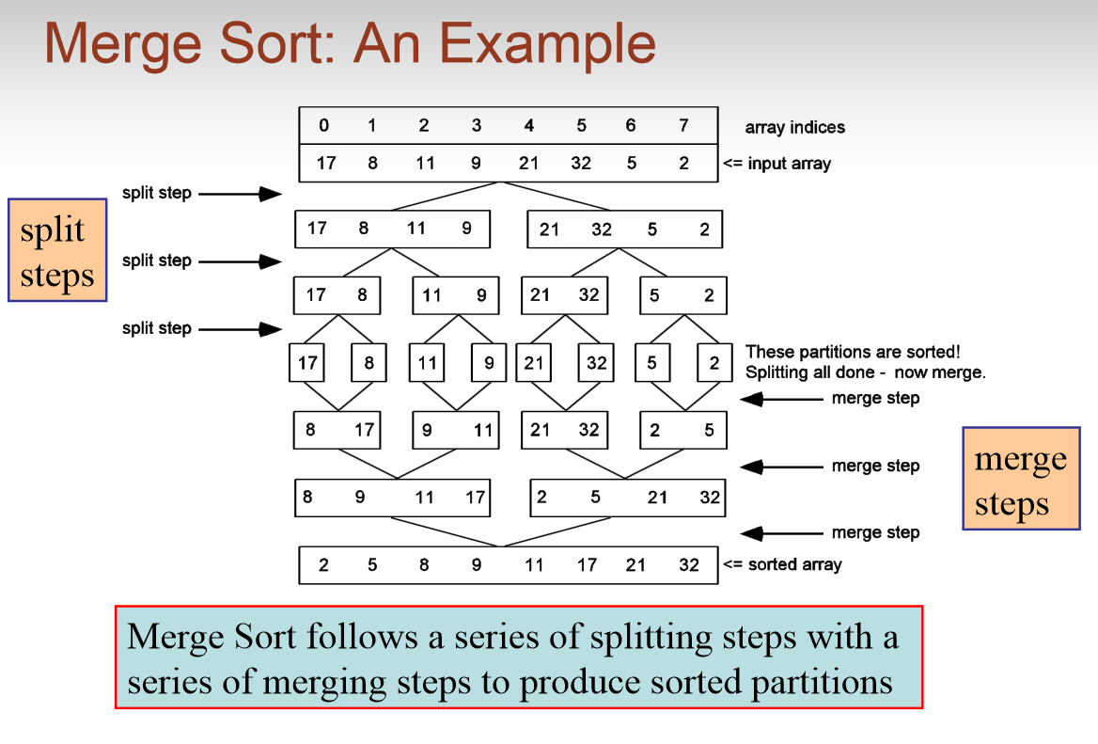
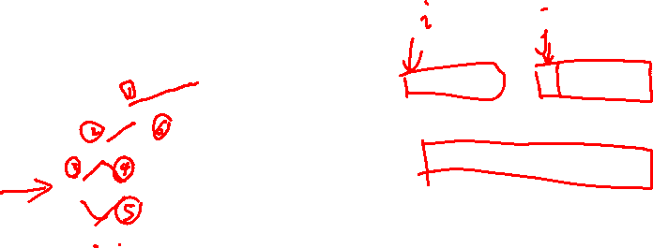

Slide 21
How many split layers are there?
log(N)
N
N²

Slide 22
There are at most N operations total executed at each split layer (we could be more exact, but we’ll see it doesn’t matter)

Slide 23
How many merge layers are there?
log(N)
N
N²

Slide 24

How many comparisons are made at each merge layer? (total)
log(N)
N
N²

Slide 25
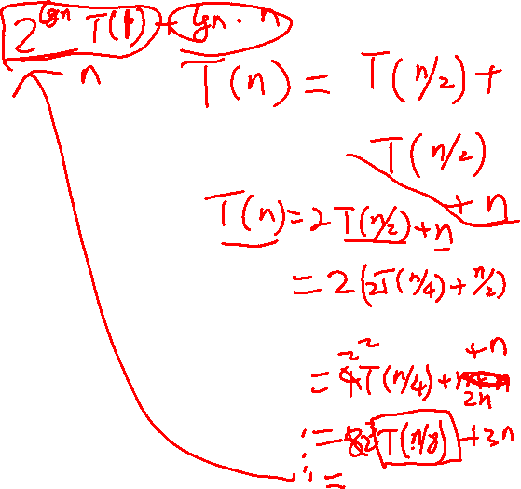
Running time for Mergesort:
log(N)*N + log(N)*N = O(N*log(N))

Slide 26
public class SortFast {
public static String s(int[] arr) { return Arrays.toString(arr); }
public static int[] combine(int[] part1, int[] part2) {
int index1 = 0, index2 = 0;
int[] combined = new int[part1.length + part2.length];
while(index1 < part1.length && index2 < part2.length) {
if(part1[index1] < part2[index2]) {
combined[index1 + index2] = part1[index1];
index1 += 1;
}
else {
combined[index1 + index2] = part2[index2];
index2 += 1;
}
}
while(index1 < part1.length) {
combined[index1 + index2] = part1[index1]; index1 += 1;
}
while(index2 < part2.length) {
combined[index1 + index2] = part2[index2]; index2 += 1;
}
System.out.println(s(part1) + " + " + s(part2) + " -> " + s(combined));
return combined;
}
public static int[] sortC(int[] arr) {
if(arr.length <= 1) { return arr; }
else {
int[] part1 = Arrays.copyOfRange(arr, 0, arr.length / 2);
int[] part2 = Arrays.copyOfRange(arr, arr.length / 2, arr.length);
System.out.println(s(arr) + " -> " + s(part1) + " + " + s(part2));
int[] sortedPart1 = sortC(part1);
int[] sortedPart2 = sortC(part2);
int[] sorted = combine(sortedPart1, sortedPart2);
return sorted;
}}}
public static void main(String[] args) {
int[] result = SortFast.sortC(new int[]{34, 93, 12, 49, 69, 25, 39 });
System.out.println(SortFast.s(result));}

